Slide 1

BCS2313: Artificial Intelligence Techniques
Modul 2.2:
BASIC SEARCH STRATEGIES (UNINFORMED SEARCH)

Slide 2

Learning Objectives
Uninformed Search Strategies

Slide 3
Uninformed Search Strategies

Slide 4
Uninformed search strategies (Blind search)
Uninformed (blind) strategies use only the information available in the problem definition. These strategies order nodes without using any domain specific information
Contrary to Informed search techniques which might have additional information (e.g. a compass).
Breadth-first search
Uniform-cost search
Depth-first search
Depth-limited search
Iterative deepening search
Bidirectional search

Slide 5
Basic Search Algorithms Uninformed Search
Breadth First Search (BFS)

Slide 6
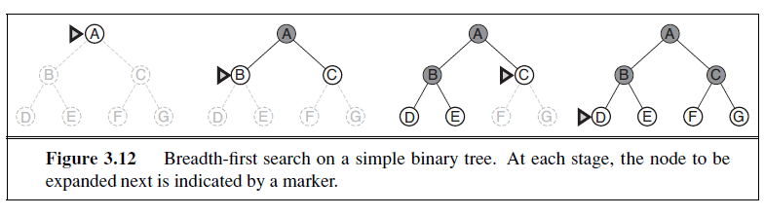
Breadth First Search (BFS)
Source: : Russell and Norvig, “Artificial Intelligence: A Modern Approach”. 3rd Edition
Main idea: Expand all nodes at depth (i) before expanding nodes at depth (i + 1). Level-order Traversal.
Implementation: Use of a First-In-First-Out queue (FIFO); nodes visited first are expanded first. New nodes (which are always deeper than their parents) go to the back of the queue, and old nodes, which are shallower than the new nodes, get expanded first. Enqueue nodes in FIFO (first-in, first-out) order.

Slide 7
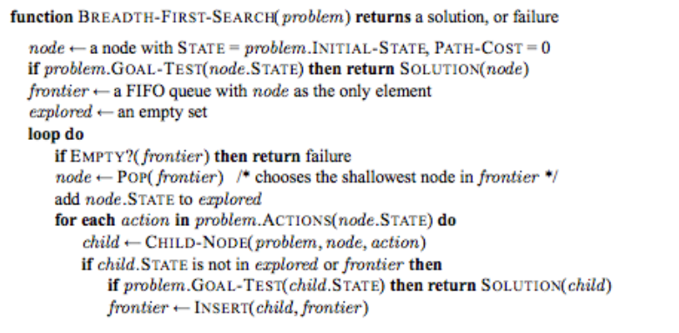
Pseudocode

Slide 8
Breadth First Search (BFS) Conti…
Complete? Yes- if the shallowest goal node is at some finite depth d, breadth-first search will eventually find it after generating all shallower nodes (provided the branching factor b is finite)
Optimal? Yes, if path cost is nondecreasing function of the depth of the node
Time Complexity: O(b^{d})
Space Complexity: O(b^{d}), note that every node in the fringe is kept in the queue.

Slide 9
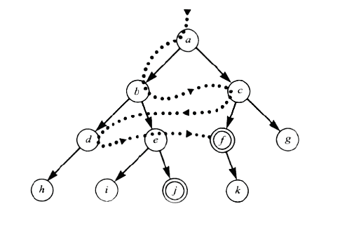
Breadth First Search (BFS) Conti…

Slide 10
Breadth First Search (BFS) Conti…
Application1:
Given the following state space (tree search), give the sequence of visited nodes when using BFS (assume that the nodeO is the goal state):
A
B
C
D
E
F
G
H
I
J
K
L
M
N
O

Slide 11
Breadth First Search (BFS) Conti…
A,
A
B
C
D
E

Slide 12
Breadth First Search (BFS) Conti…
A,
B,
A
B
C
D
E
F
G

Slide 13
Breadth First Search (BFS) Conti…
A,
B,C
A
B
C
D
E
F
G
H

Slide 14
Breadth First Search (BFS) Conti…
A,
B,C,D
A
B
C
D
E
F
G
H
I
J

Slide 15
Breadth First Search (BFS) Conti…
A,
B,C,D
A
B
C
D
E
F
G
H
I
J

Slide 16
Breadth First Search (BFS) Conti…
A,
B,C,D,E
A
B
C
D
E
F
G
H
I
J

Slide 17
Breadth First Search (BFS) Conti…
A,
B,C,D,E,
F,
A
B
C
D
E
F
G
H
I
J

Slide 18
Breadth First Search (BFS) Conti…
A,
B,C,D,E,
F,G
A
B
C
D
E
F
G
H
I
J
K
L

Slide 19
Breadth First Search (BFS) Conti…
A,
B,C,D,E,
F,G,H
A
B
C
D
E
F
G
H
I
J
K
L

Slide 20
Breadth First Search (BFS) Conti…
A,
B,C,D,E,
F,G,H,I
A
B
C
D
E
F
G
H
I
J
K
L
M

Slide 21
Breadth First Search (BFS) Conti…
A,
B,C,D,E,
F,G,H,I,J,
A
B
C
D
E
F
G
H
I
J
K
L
M
N

Slide 22
Breadth First Search (BFS) Conti…
A,
B,C,D,E,
F,G,H,I,J,
K,
A
B
C
D
E
F
G
H
I
J
K
L
M
N

Slide 23
Breadth First Search (BFS) Conti…
A,
B,C,D,E,
F,G,H,I,J,
K,L
A
B
C
D
E
F
G
H
I
J
K
L
M
N
O

Slide 24
Breadth First Search (BFS) Conti…
A,
B,C,D,E,
F,G,H,I,J,
K,L, M,
A
B
C
D
E
F
G
H
I
J
K
L
M
N
O

Slide 25
Breadth First Search (BFS) Conti…
A,
B,C,D,E,
F,G,H,I,J,
K,L, M,N,
A
B
C
D
E
F
G
H
I
J
K
L
M
N
O

Slide 26
Breadth First Search (BFS) Conti…
A,
B,C,D,E,
F,G,H,I,J,
K,L, M,N,
Goal state: O
A
B
C
D
E
F
G
H
I
J
K
L
M
N
O

Slide 27
Breadth First Search (BFS) Conti…
The returned solution is the sequence of operators in the path:
A, B, G, L, O
A
B
C
D
E
F
G
H
I
J
K
L
M
N
O

Slide 28
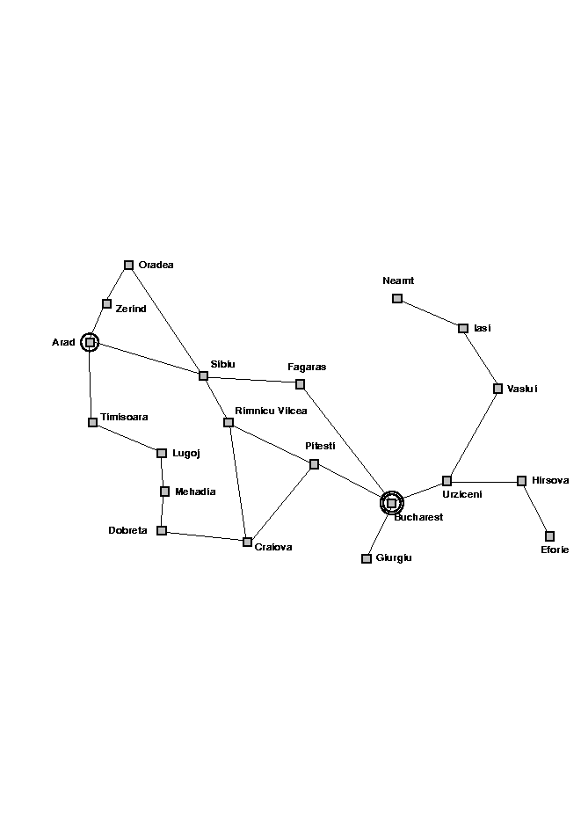

Slide 29
Breadth First Search
QUEUING-FN:- successors added to end of queue
Arad
Zerind
Sibiu
Timisoara
Arad
Oradea
Fagaras
Arad
Oradea
Arad
Lugoj
Rimnicu Vilcea
Shallow nodes are expanded before deeper nodes.

Slide 30
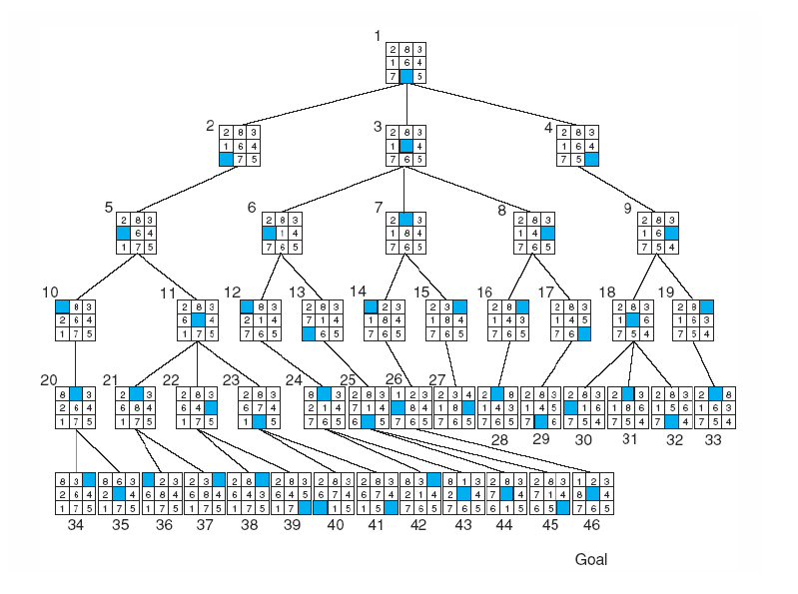
8-puzzle

Slide 31
Basic Search Algorithms Uninformed Search
Uniform Cost Search (UCS)

Slide 32
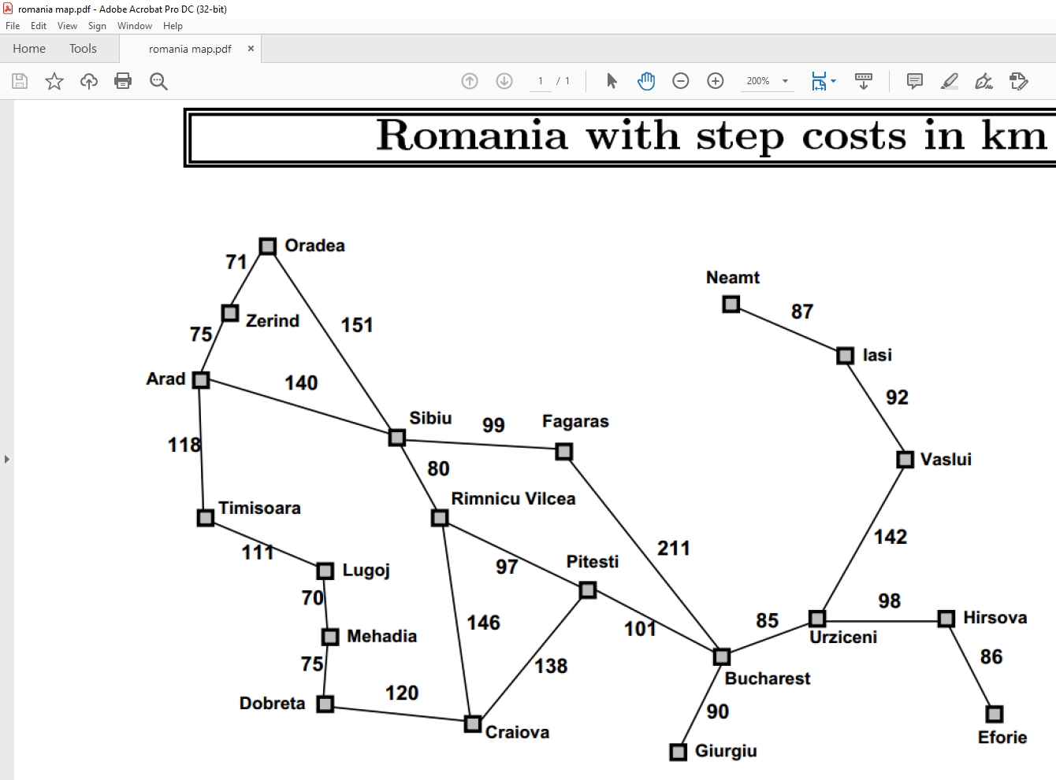

Slide 33
Uniform Cost Search (UCS)
When all step costs are equal, breadth-first search is optimal because it always expands the shallowest unexpanded node.
For any step-cost function, Uniform Cost search expands the node n with the lowest path cost g(n).
UCS takes into account the total cost: g(n).
UCS is guided by path costs rather than depths. Nodes are ordered according to their path cost.

Slide 34
Uniform Cost Search (UCS) Conti…
Main idea: Expand the cheapest node. Where the cost is the path cost g(n).
Implementation:
Enqueue nodes in order of cost g(n).
QUEUING-FN:- insert in order of increasing path cost.
Enqueue new node at the appropriate position in the queue so that we dequeue the cheapest node.
Complete? Yes. UCS expands nodes in order of optimal path cost
Optimal? Yes, if path cost is nondecreasing function of depth
Time Complexity: O(b^{d})
Space Complexity: O(b^{d}), note that every node in the fringe keep in the queue.

Slide 35
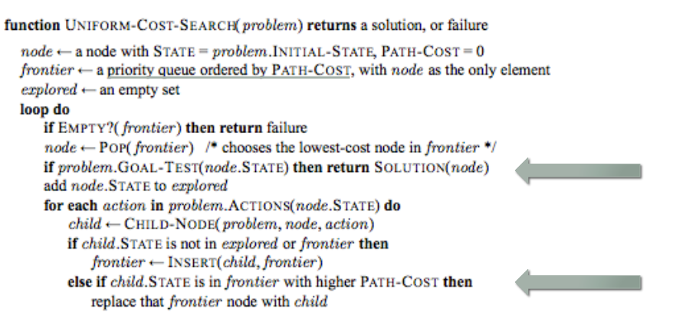
Pseudocode

Slide 36
Uniform Cost Search (UCS) Conti…
5
2
[5]
[2]
1
4
1
7
[6]
[3]
[9]
[9]
Goal state
4
5
[x] = g(n)
path cost of node n
[7]
[8]

Slide 37
Uniform Cost Search (UCS) Conti…
5
2
[5]
[2]

Slide 38
Uniform Cost Search (UCS) Conti…
5
2
[5]
[2]
1
7
[3]
[9]

Slide 39
Uniform Cost Search (UCS) Conti…
5
2
[5]
[2]
1
7
[3]
[9]
4
5
[7]
[8]

Slide 40
Uniform Cost Search (UCS) Conti…
5
2
[5]
[2]
1
4
1
7
[6]
[3]
[9]
[9]
4
5
[7]
[8]

Slide 41
Uniform Cost Search (UCS) Conti…
5
2
[5]
[2]
Goal state path cost g(n)=[6]
1
4
1
7
[3]
[9]
[9]
4
5
[7]
[8]

Slide 42
Uniform Cost Search (UCS) Conti…
5
2
[5]
[2]
1
4
1
7
[6]
[3]
[9]
[9]
4
5
[7]
[8]

Slide 43
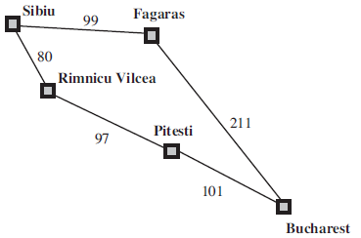
Uniform Cost Search (UCS) Conti…
The successors of Sibiu are Rimnicu Vilcea and Fagaras, with costs 80 and 99, respectively.
The least-cost node, Rimnicu Vilcea, is expanded next, adding Pitesti with cost 80 + 97=177.
The least-cost node is now Fagaras, so it is expanded, adding Bucharest with cost 99+211=310.
Now a goal node has been generated, but uniform-cost search keeps going, choosing Pitesti for expansion and adding a second path to Bucharest with cost 80+97+101= 278.
Figure 3.15 Part of the Romania state space, selected to illustrate uniform-cost search
Source: : Russell and Norvig, “Artificial Intelligence: A Modern Approach”. 3rd Edition
Continue….
Now the algorithm checks to see if this new path is better than the old one; it is, so the old one is discarded.
Bucharest, now with g-cost 278, is selected for expansion and the solution is returned (Sibiu-Rimnicu Vilcea-Pitesti-Bucharest).

Slide 44
Basic Search Algorithms Uninformed Search
Depth First Search (DFS)

Slide 45
Depth First Search (DFS)
Main idea: Expand node at the deepest level (breaking ties left to right). The search proceeds immediately to the deepest level of the search tree, where the nodes have no successors.
Implementation: use of a Last-In-First-Out queue or stack(LIFO). Enqueue nodes in LIFO (last-in, first-out) order.
Complete? No. fails in infinite-depth spaces with loops, but is complete in finite spaces (when avoiding repeated states)
Optimal? No.
Time Complexity: O(b^{m}), where m is the maximum depth.
Space Complexity: O(bm), where m is the maximum depth.

Slide 46
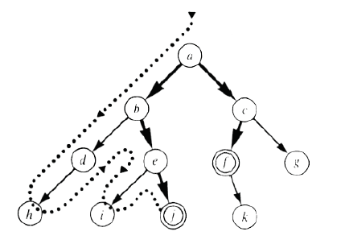
Depth First Search (DFS) Conti…..

Slide 47
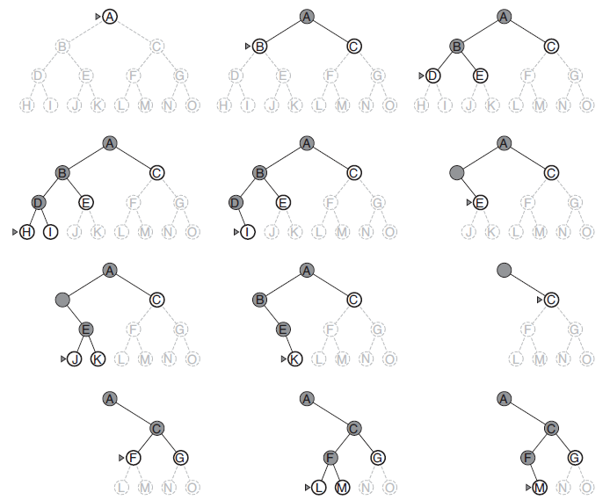
Depth First Search (DFS) Conti…..
Figure 3.16 Depth-first search on a binary tree. The unexplored region is shown in light
gray. Explored nodes with no descendants in the frontier are removed from memory. Nodes
at depth 3 have no successors and M is the only goal node.
Source: : Russell and Norvig, “Artificial Intelligence: A Modern Approach”. 3rd Edition

Slide 48
Depth First Search (DFS) Conti…..
Application2:
Given the following state space (tree search), give the sequence of visited nodes when using DFS (assume that the node O is the goal state):
A
B
C
D
E
F
G
H
I
J
K
L
M
N
O

Slide 49
Depth First Search (DFS) Conti…..
A,
A
B
C
D
E

Slide 50
Depth First Search (DFS) Conti…..
A,B,
A
B
C
D
E
F
G

Slide 51
Depth First Search (DFS) Conti…..
A,B,F,
A
B
C
D
E
F
G

Slide 52
Depth First Search (DFS) Conti…..
A,B,F,
G,
A
B
C
D
E
F
G
K
L

Slide 53
Depth First Search (DFS) Conti…..
A,B,F,
G,K,
A
B
C
D
E
F
G
K
L

Slide 54
Depth First Search (DFS) Conti…..
A,B,F,
G,K,
L,
A
B
C
D
E
F
G
K
L
O

Slide 55
Depth First Search (DFS) Conti…..
A,B,F,
G,K,
L, O: Goal State
A
B
C
D
E
F
G
K
L
O

Slide 56
Depth First Search (DFS) Conti…..
The returned solution is the sequence of operators in the path: A, B, G, L, O
A
B
C
D
E
F
G
K
L
O

Slide 58
Depth First Search (DFS) Conti…..
QUEUING-FN:- insert successors at front of queue
Arad
Zerind
Sibiu
Timisoara
Arad
Oradea
Zerind
Sibiu
Timisoara

Slide 59
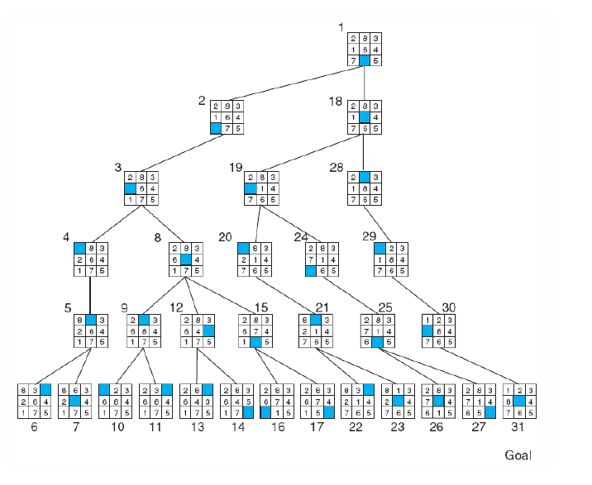
8-puzzle

Slide 60
8-puzzle

Slide 61
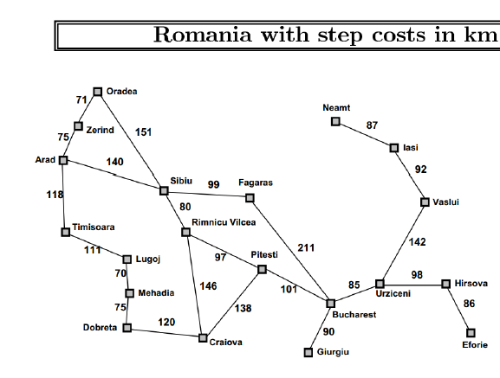

Slide 62
Basic Search Algorithms Uninformed Search
Depth-Limited Search (DLS)

Slide 63
Depth-Limited Search (DLS)
It is simply DFS with a depth bound.
Searching is not permitted beyond the depth bound.
Works well if we know what the depth of the solution is.
Termination is guaranteed.
If the solution is beneath the depth bound, the search cannot find the goal (hence this search algorithm is incomplete).
Otherwise use Iterative deepening search (IDS).

Slide 64
Depth-Limited Search (DLS)
Main idea: Expand node at the deepest level, but limit depth to L.
Implementation:
Enqueue nodes in LIFO (last-in, first-out) order. But limit depth to L
Complete? Yes if there is a goal state at a depth less than L
Optimal? No
Time Complexity: O(b^{L}), where L is the cutoff.
Space Complexity: O(bL), where L is the cutoff.

Slide 65
Depth-Limited Search (DLS)
Application3:
Given the following state space (tree search), give the sequence of visited nodes when using DLS (Limit = 2):
Limit = 0
A
Limit = 1
B
C
D
E
Limit = 2
F
G
H
I
J
K
L
M
N
O

Slide 66
Depth-Limited Search (DLS)
A,
A
B
C
D
E
Limit = 2

Slide 67
Depth-Limited Search (DLS)
A,B,
A
B
C
D
E
Limit = 2
F
G

Slide 68
Depth-Limited Search (DLS)
A,B,F,
A
B
C
D
E
Limit = 2
F
G

Slide 69
Depth-Limited Search (DLS)
A,B,F,
G,
A
B
C
D
E
Limit = 2
F
G

Slide 70
Depth-Limited Search (DLS)
A,B,F,
G,
C,
A
B
C
D
E
Limit = 2
F
G
H

Slide 71
Depth-Limited Search (DLS)
A,B,F,
G,
C,H,
A
B
C
D
E
Limit = 2
F
G
H

Slide 72
Depth-Limited Search (DLS)
A,B,F,
G,
C,H,
D,
A
B
C
D
E
Limit = 2
F
G
H
I
J

Slide 73
Depth-Limited Search (DLS)
A,B,F,
G,
C,H,
D,I
A
B
C
D
E
Limit = 2
F
G
H
I
J

Slide 74
Depth-Limited Search (DLS)
A,B,F,
G,
C,H,
D,I
J,
A
B
C
D
E
Limit = 2
F
G
H
I
J

Slide 75
Depth-Limited Search (DLS)
A,B,F,
G,
C,H,
D,I
J,
E
A
B
C
D
E
Limit = 2
F
G
H
I
J

Slide 76
Depth-Limited Search (DLS)
A,B,F,
G,
C,H,
D,I
J,
E, Failure
A
B
C
D
E
Limit = 2
F
G
H
I
J

Slide 77
Depth-Limited Search (DLS)
DLS algorithm returns Failure (no solution)
The reason is that the goal is beyond the limit (Limit =2): the goal depth is (d=4)
A
B
C
D
E
Limit = 2
F
G
H
I
J
K
L
M
N
O

Slide 78

Depth-Limited Search (DLS)
Depth Bound = 3

Slide 79
Basic Search Algorithms Uninformed Search
Iterative Deepening Search (IDS)

Slide 80
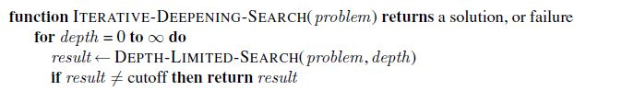
Iterative Deepening Search (IDS)
Figure 3.18 The iterative deepening search algorithm, which repeatedly applies depth limited search with increasing limits. It terminates when a solution is found or if the depth limited search returns failure, meaning that no solution exists.
Source: : Russell and Norvig, “Artificial Intelligence: A Modern Approach”. 3rd Edition

Slide 81
Iterative Deepening Search (IDS)
Key idea: Iterative deepening search (IDS) applies DLS repeatedly with increasing depth. It terminates when a solution is found or no solutions exists.
IDS combines the benefits of BFS and DFS: Like DFS the memory requirements are very modest (O(bd)). Like BFS, it is complete when the branching factor is finite and optimal when the path cost is a nondecreasing function of the depth of the node.
The nodes on the bottom level (depth d) are generated once, those on the next-to-bottom level are generated twice, and so on, up to the children of the root, which are generated d times.
So the total number of nodes generated in the worst case is:
N(IDS)=(d)b + (d-1) b² + …+(1)b^{d}
which gives a time complexity of O(bd)—asymptotically the same as breadth first search.
In general, iterative deepening is the preferred uninformed search method when the search space is large and the depth of the solution is not known.

Slide 82
Iterative Deepening Search (IDS)
L = 0
L = 1
L = 2
L = 3

Slide 83
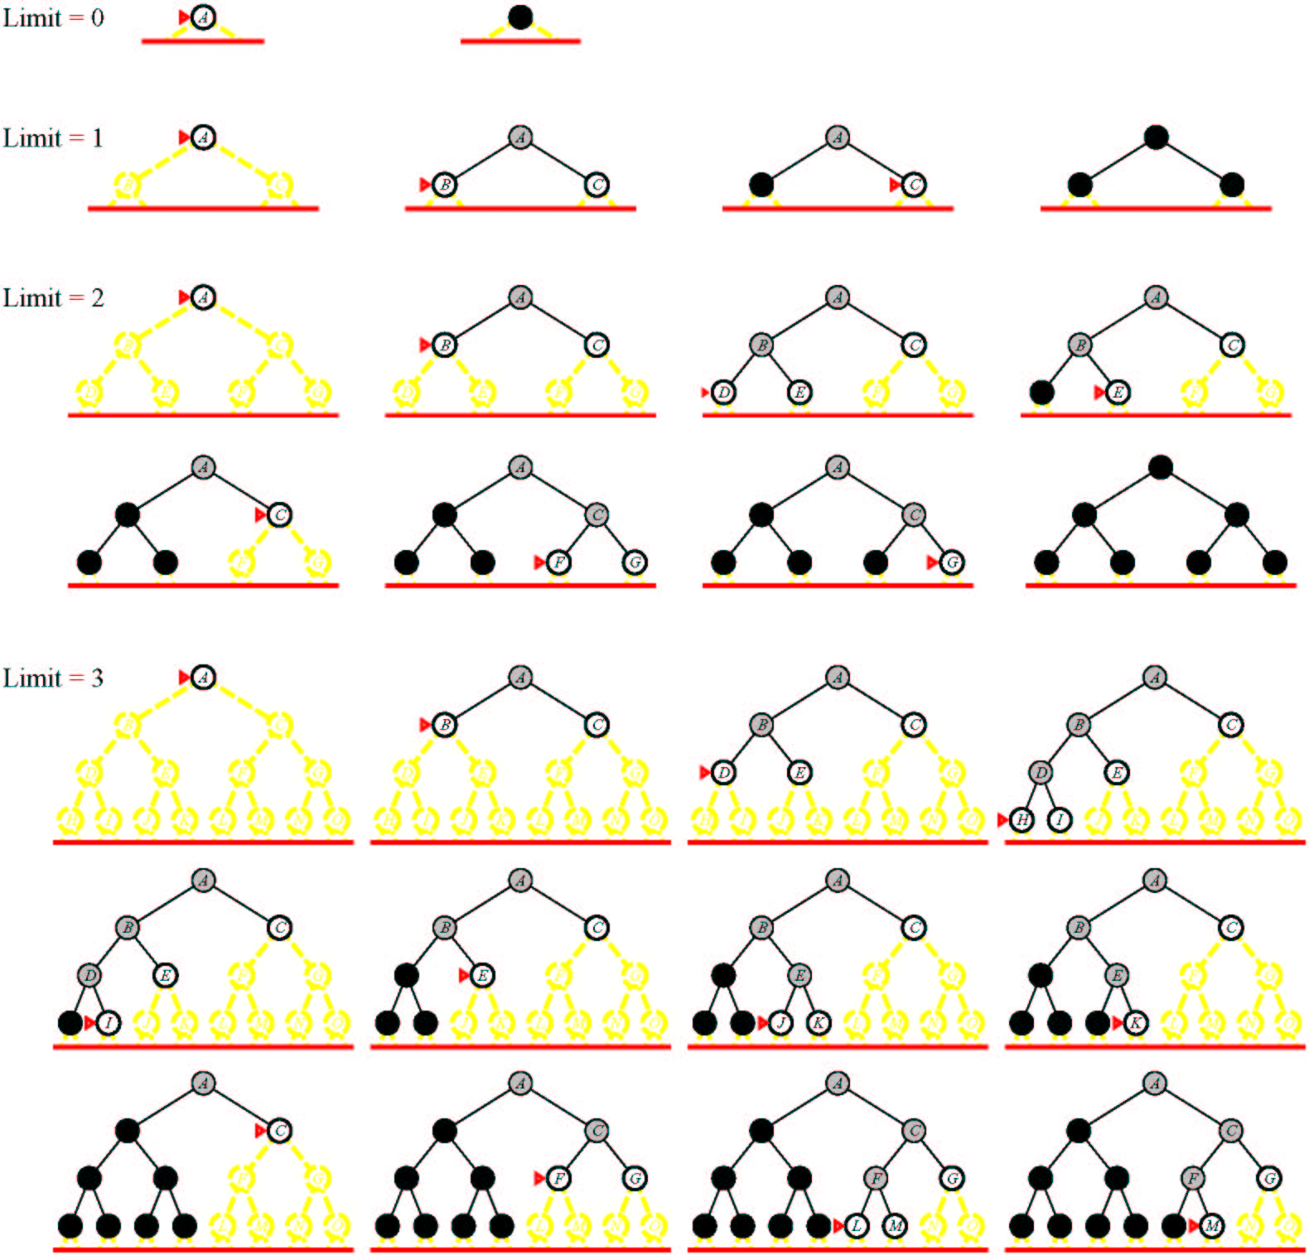
Iterative Deepening Search (IDS)

Slide 84
Iterative Deepening Search (IDS)
Application4:
Given the following state space (tree search), give the sequence of visited nodes when using IDS:
Limit = 0
A
Limit = 1
B
C
D
E
Limit = 2
F
G
H
I
J
Limit = 3
K
L
M
N
Limit = 4
O

Slide 85
Iterative Deepening Search (IDS)
DLS with bound = 0

Slide 86
Iterative Deepening Search (IDS)
A,
Limit = 0
A

Slide 87
Iterative Deepening Search (IDS)
A, Failure
Limit = 0
A

Slide 88
Iterative Deepening Search (IDS)
DLS with bound = 1

Slide 89
Iterative Deepening Search (IDS)
A,
A
Limit = 1
B
C
D
E

Slide 90
Iterative Deepening Search (IDS)
A,B,
A
Limit = 1
B
C
D
E

Slide 91
Iterative Deepening Search (IDS)
A,B,
C,
A
Limit = 1
B
C
D
E

Slide 92
Iterative Deepening Search (IDS)
A,B,
C,
D,
A
Limit = 1
B
C
D
E

Slide 93
Iterative Deepening Search (IDS)
A,B
C,
D,
E,
A
Limit = 1
B
C
D
E

Slide 94
Iterative Deepening Search (IDS)
A,B,
C,
D,
E, Failure
A
Limit = 1
B
C
D
E

Slide 95
Iterative Deepening Search (IDS)
A,
A
B
C
D
E
Limit = 2

Slide 96
Iterative Deepening Search (IDS)
A,B,
A
B
C
D
E
Limit = 2
F
G

Slide 97
Iterative Deepening Search (IDS)
A,B,F,
A
B
C
D
E
Limit = 2
F
G

Slide 98
Iterative Deepening Search (IDS)
A,B,F,
G,
A
B
C
D
E
Limit = 2
F
G

Slide 99
Iterative Deepening Search (IDS)
A,B,F,
G,
C,
A
B
C
D
E
Limit = 2
F
G
H

Slide 100
Iterative Deepening Search (IDS)
A,B,F,
G,
C,H,
A
B
C
D
E
Limit = 2
F
G
H

Slide 101
Iterative Deepening Search (IDS)
A,B,F,
G,
C,H,
D,
A
B
C
D
E
Limit = 2
F
G
H
I
J

Slide 102
Iterative Deepening Search (IDS)
A,B,F,
G,
C,H,
D,I
A
B
C
D
E
Limit = 2
F
G
H
I
J

Slide 103
Iterative Deepening Search (IDS)
A,B,F,
G,
C,H,
D,I
J,
A
B
C
D
E
Limit = 2
F
G
H
I
J

Slide 104
Iterative Deepening Search (IDS)
A,B,F,
G,
C,H,
D,I
J,
E
A
B
C
D
E
Limit = 2
F
G
H
I
J

Slide 105
Iterative Deepening Search (IDS)
A,B,F,
G,
C,H,
D,I
J,
E, Failure
A
B
C
D
E
Limit = 2
F
G
H
I
J
K
L
M
N
O

Slide 106
Iterative Deepening Search (IDS)
DLS with bound = 3

Slide 107
Iterative Deepening Search (IDS)
A,
A
B
C
D
E
Limit = 3

Slide 108
Iterative Deepening Search (IDS)
A,B,
A
B
C
D
E
F
G
Limit = 3

Slide 109
Iterative Deepening Search (IDS)
A,B,F,
A
B
C
D
E
F
G
Limit = 3

Slide 110
Iterative Deepening Search (IDS)
A,B,F,
G,
A
B
C
D
E
F
G
Limit = 3
K
L

Slide 111
Iterative Deepening Search (IDS)
A,B,F,
G,K,
A
B
C
D
E
F
G
Limit = 3
K
L

Slide 112
Iterative Deepening Search (IDS)
A,B,F,
G,K,
L,
A
B
C
D
E
F
G
Limit = 3
K
L

Slide 113
Iterative Deepening Search (IDS)
A,B,F,
G,K,
L,
C,
A
B
C
D
E
F
G
H
Limit = 3
K
L

Slide 114
Iterative Deepening Search (IDS)
A,B,F,
G,K,
L,
C,H,
A
B
C
D
E
F
G
H
Limit = 3
K
L

Slide 115
Iterative Deepening Search (IDS)
A,B,F,
G,K,
L,
C,H,
D,
A
B
C
D
E
F
G
H
I
J
Limit = 3
K
L

Slide 116
Iterative Deepening Search (IDS)
A,B,F,
G,K,
L,
C,H,
D,I,
A
B
C
D
E
F
G
H
I
J
Limit = 3
K
L
M

Slide 117
Iterative Deepening Search (IDS)
A,B,F,
G,K,
L,
C,H,
D,I,M,
A
B
C
D
E
F
G
H
I
J
Limit = 3
K
L
M

Slide 118
Iterative Deepening Search (IDS)
A,B,F,
G,K,
L,
C,H,
D,I,M,
J,
A
B
C
D
E
F
G
H
I
J
Limit = 3
K
L
M
N

Slide 119
Iterative Deepening Search (IDS)
A,B,F,
G,K,
L,
C,H,
D,I,M,
J,N,
A
B
C
D
E
F
G
H
I
J
Limit = 3
K
L
M
N

Slide 120
Iterative Deepening Search (IDS)
A,B,F,
G,K,
L,
C,H,
D,I,M,
J,N,
E,
A
B
C
D
E
F
G
H
I
J
Limit = 3
K
L
M
N

Slide 121
Iterative Deepening Search (IDS)
A,B,F,
G,K,
L,
C,H,
D,I,M,
J,N,
E,Failure
A
B
C
D
E
F
G
H
I
J
Limit = 3
K
L
M
N
O

Slide 122
Iterative Deepening Search (IDS)
DLS with bound = 4

Slide 123
Iterative Deepening Search (IDS)
A,
A
B
C
D
E
Limit = 4

Slide 124
Iterative Deepening Search (IDS)
A,B,
A
B
C
D
E
F
G
Limit = 4

Slide 125
Iterative Deepening Search (IDS)
A,B,F,
A
B
C
D
E
F
G
Limit = 4

Slide 126
Iterative Deepening Search (IDS)
A,B,F,
G,
A
B
C
D
E
F
G
K
L
Limit = 4

Slide 127
Iterative Deepening Search (IDS)
A,B,F,
G,K,
A
B
C
D
E
F
G
K
L
Limit = 4

Slide 128
Iterative Deepening Search (IDS)
A,B,F,
G,K,
L,
A
B
C
D
E
F
G
K
L
Limit = 4
O

Slide 129
Iterative Deepening Search (IDS)
A,B,F,
G,K,
L, O: Goal State
A
B
C
D
E
F
G
K
L
Limit = 4
O

Slide 130
Iterative Deepening Search (IDS)
The returned solution is the sequence of operators in the path: A, B, G, L, O
A
B
C
D
E
F
G
K
L
O

Slide 131
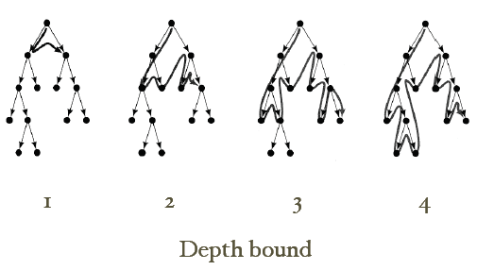
Iterative Deepening Search (IDS)

Slide 132
Basic Search Algorithms Uninformed Search
Bi-Directional Search (BDS)

Slide 133
Bi-directional Search (BDS)
Main idea: To run two simultaneous searches: Start searching from both the initial state and the goal state, meet in the middle.
Check whether the node belongs to other fringe before expansion.
Space complexity is the most significant weakness.
Complete and optimal if both searches are breadth-first.
Complete? Yes
Optimal? Yes
Time Complexity: O(b^{d/2}), where d is the depth of the solution.
Space Complexity: O(b^{d/2}), where d is the depth of the solution.

Slide 134
Basic Search Algorithms
Comparison of search algorithms

Slide 135
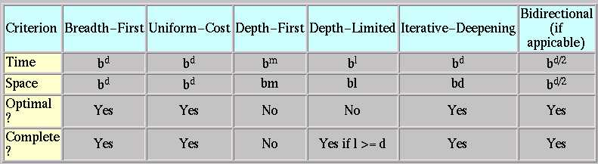
Comparison of search algorithms
b: Branching factor
d: Depth of solution
m: Maximum depth
l : Depth Limit

Slide 136
Avoiding Repeated States
In increasing order of effectiveness in reducing size of state space and with increasing computational costs:
Do not return to the state you just came from
Do not create paths with cycles in them
Do not generate any state that was ever created before
Net effect depends on frequency of “loops” in state space.

Slide 137
Summary
Search: process of constructing sequences of actions that achieve a goal given a problem.
The studied methods assume that the environment is observable, deterministic, static and completely known.
Goal formulation is the first step in solving problems by searching. It facilitates problem formulation.
Formulating a problem requires specifying four components: Initial states, operators, goal test and path cost function. Environment is represented as a state space.
A solution is a path from the initial state to a goal state.
Search algorithms are judged on the basis of completeness, optimality, time complexity and space complexity.
Several search strategies: BFS, DFS, DLS, IDS,…
All uninformed searches have an exponential time complexity – hopeless as a viable problem solving mechanism (unless you have a quantum computer!)

Slide 138

138

Slide 140
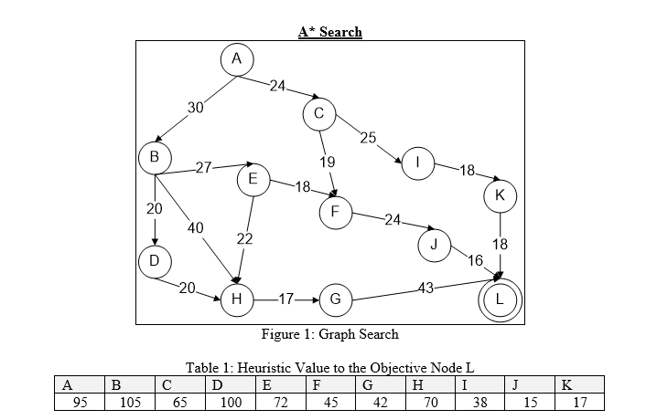

Slide 141
